Slide 1
LED Matrix Timer
…and other things
Krisztián Stancz 30.06.2017

Slide 2
We’ll discuss…
Introduction to LEDs
Driving LEDs
Multiplexing and Charlieplexing
Using shift registers
A look into the code
Having more than 4 colors
LED matrix prices

Slide 3
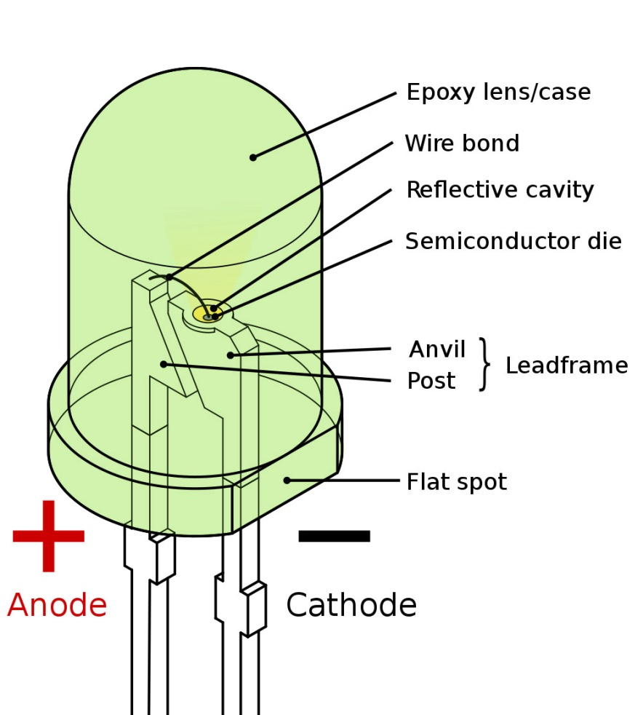
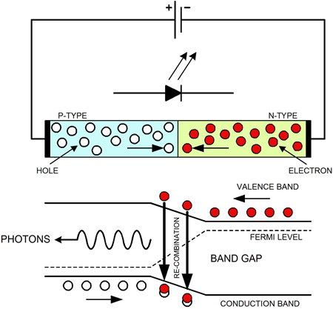
LED basics

Slide 4
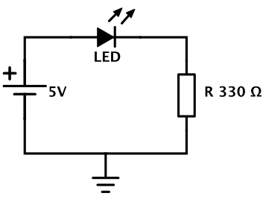
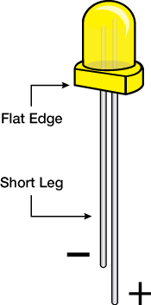
Basic LED circuit
Anode
Cathode
R = U_{R} / I_{R}
Cathode
R = (U_{PowerSupply} - U_{LED}) / I_{LED}
Anode

Slide 5
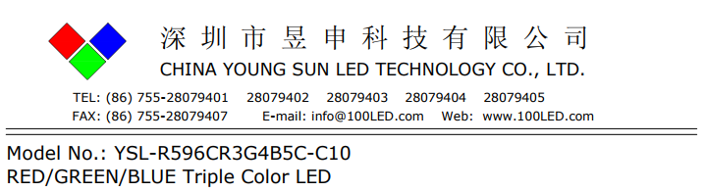
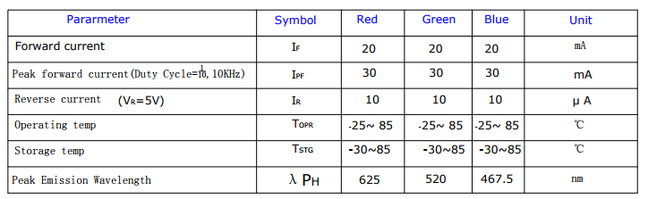
How to find U_{LED} and I_{LED}

Slide 6
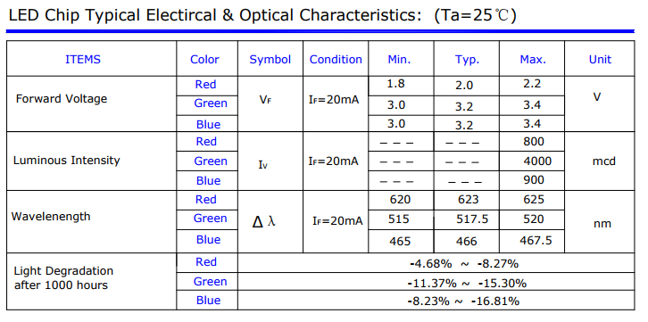
R = (U_{PowerSupply}-U_{F}) / I_{F}
R = (5V – 1.8V) / 20 mA
R = 160 ohm

Slide 7
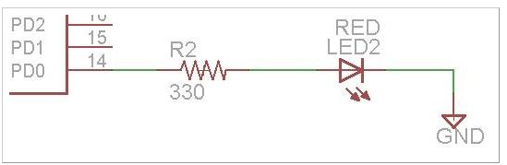
Driving LEDs with an MCU
DDRD |= (1 << DDRD0);
PORTD |= (1 << PORTD0);
Output
5V

Slide 8
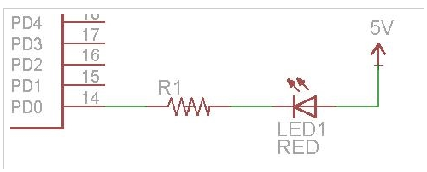
Driving LEDs with an MCU
Output
0V
DDRD |= (1 << DDRD0);
PORTD &= ~(1 << PORTD0);

Slide 9
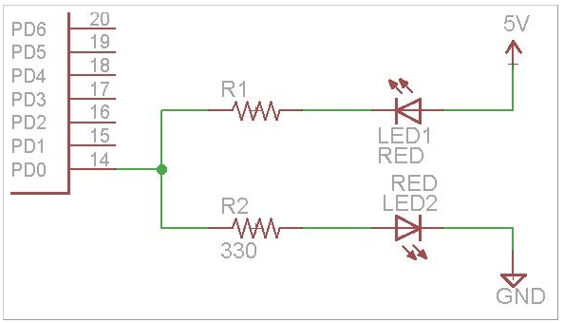
Driving LEDs with an MCU
DDRD |= (1 << DDRD0);
while (1) {
PIND |= (1 << PIND0);
_ms_delay(500);
}

Slide 10
Confusing detour
DDRD |= (1 << DDRD0);
PORTD |= (1 << PORTD0);
Output
5V
current
flow

Slide 11
Confusing detour
DDRD |= (1 << DDRD0);
PORTD &= ~(1 << PORTD0);
Output
0 V
current
flow
WTF???

Slide 12
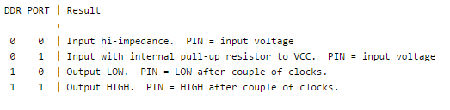
Confusing detour

Slide 13
Confusing detour
Output = Control the environment
Input = Observe the environment
Work with voltages

Slide 14
Tri-state pins

Slide 15
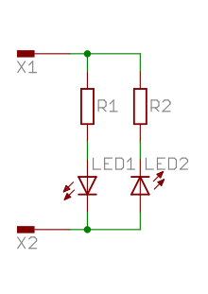
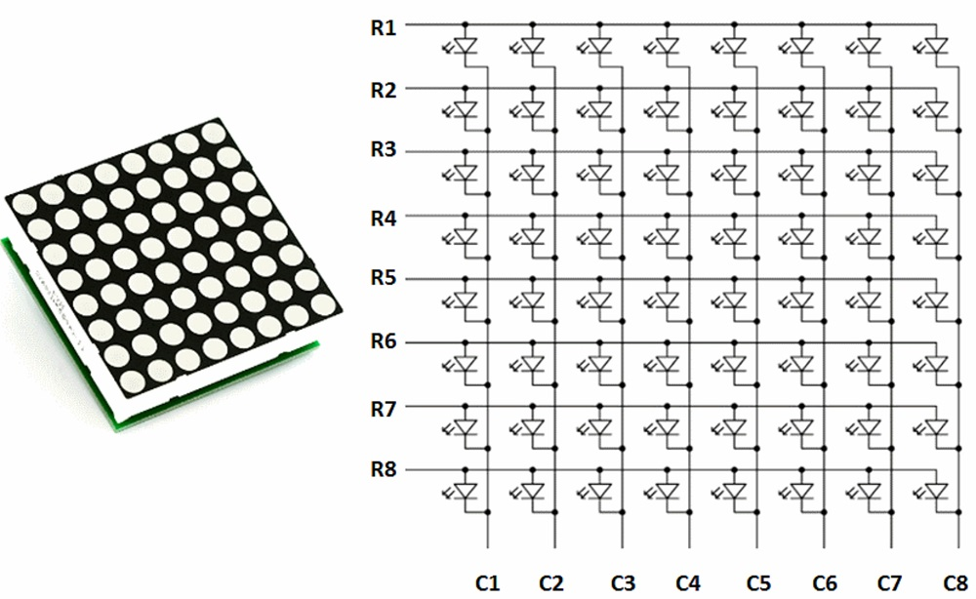
Multiplexing vs Charlieplexing
C1
2 pins
2 pins

Slide 16
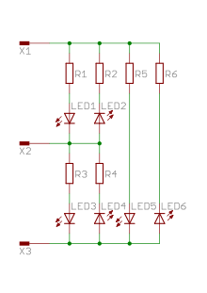
Multiplexing vs Charlieplexing
Output 5V
Output 0V
Output 5V
Output 0V
Output 0V
C1 C2
Input High Impedance
Output 0V
Output 5V
5 pins
3 pins
for N pins:
(N² / 4) LEDs
(N² – N) LEDs

Slide 17
8x8 LED matrix
64 LEDs
16 pins

Slide 18
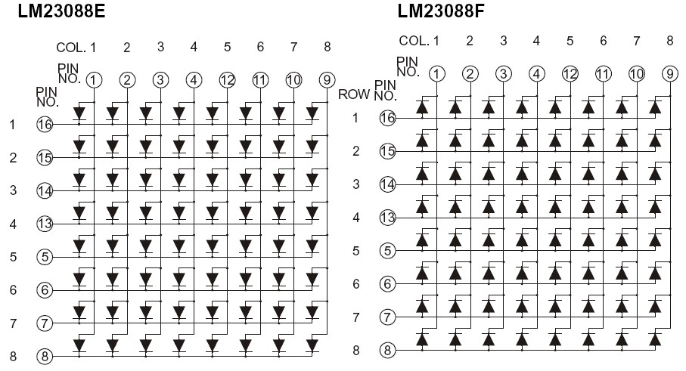
8x8 LED matrix
Common anode
Common cathode
0V
0V
0V
0V
5V
0V
0V
0V
5V
5V
5V
5V
0V
5V
5V
5V
0V 0V 0V 5V 0V 0V 0V 0V
5V 5V 5V 0V 5V 5V 5V 5V

Slide 19
8x8 LED matrix
Common anode
Common cathode
0V
0V
0V
0V
5V
0V
0V
0V
0V
0V
0V
0V
0V
0V
0V
0V
0V 0V 0V 5V 0V 0V 0V 0V
0V 0V 0V 0V 0V 0V 0V 0V

Slide 20
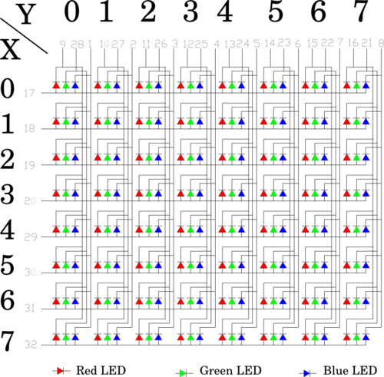
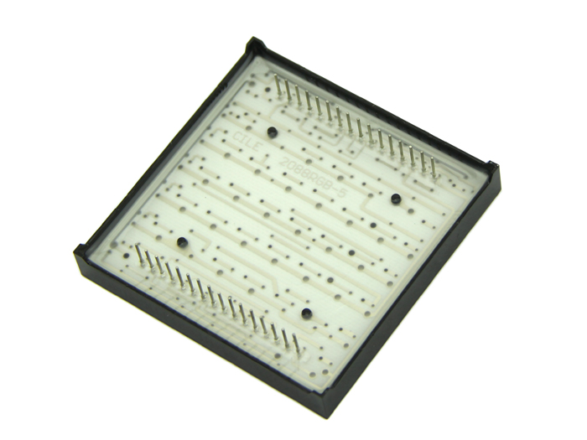
8x8 RGB LED matrix (common cathode)
192 LEDs
32 pins

Slide 21
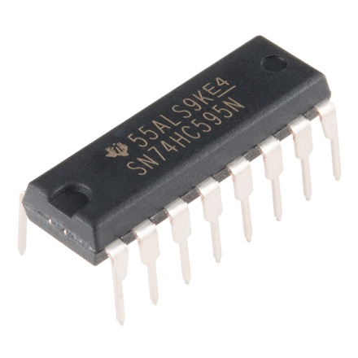
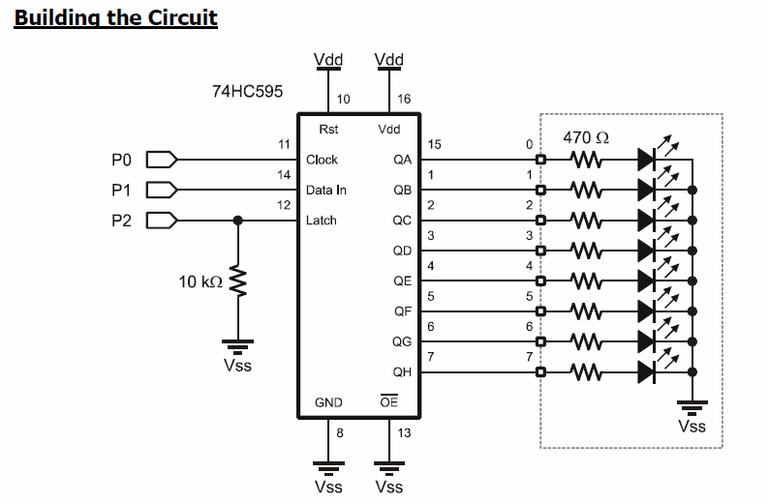
Shif register (74HC595N)
MCU

Slide 22
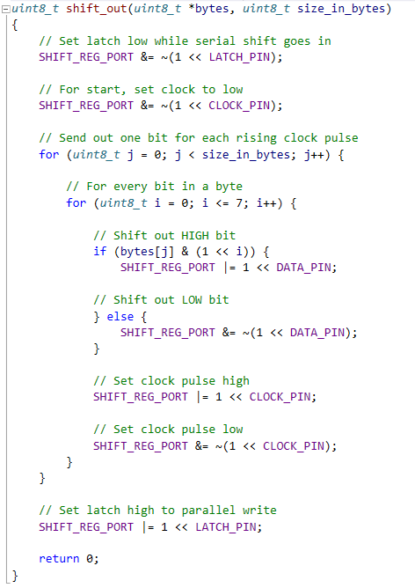
Shifting out

Slide 23
Daisy chaining shift registers
From MCU
data pin
Parallel data out when latch high
Parallel data out when latch high
Serial data in when latch low
Serial data in when latch low
Latch
Latch
Clock
To next IC
Clock
Serial data overflow
Serial data overflow

Slide 24
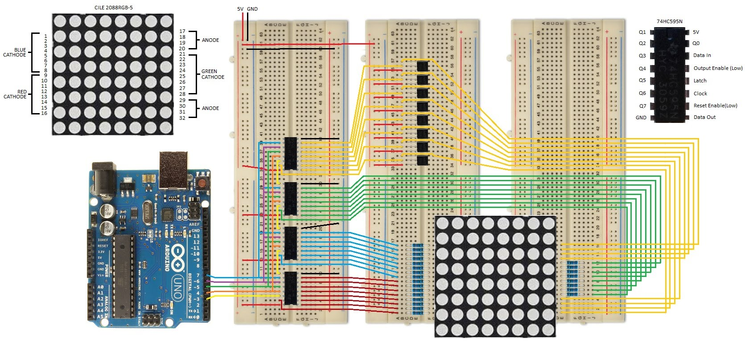
Putting it together

Slide 25
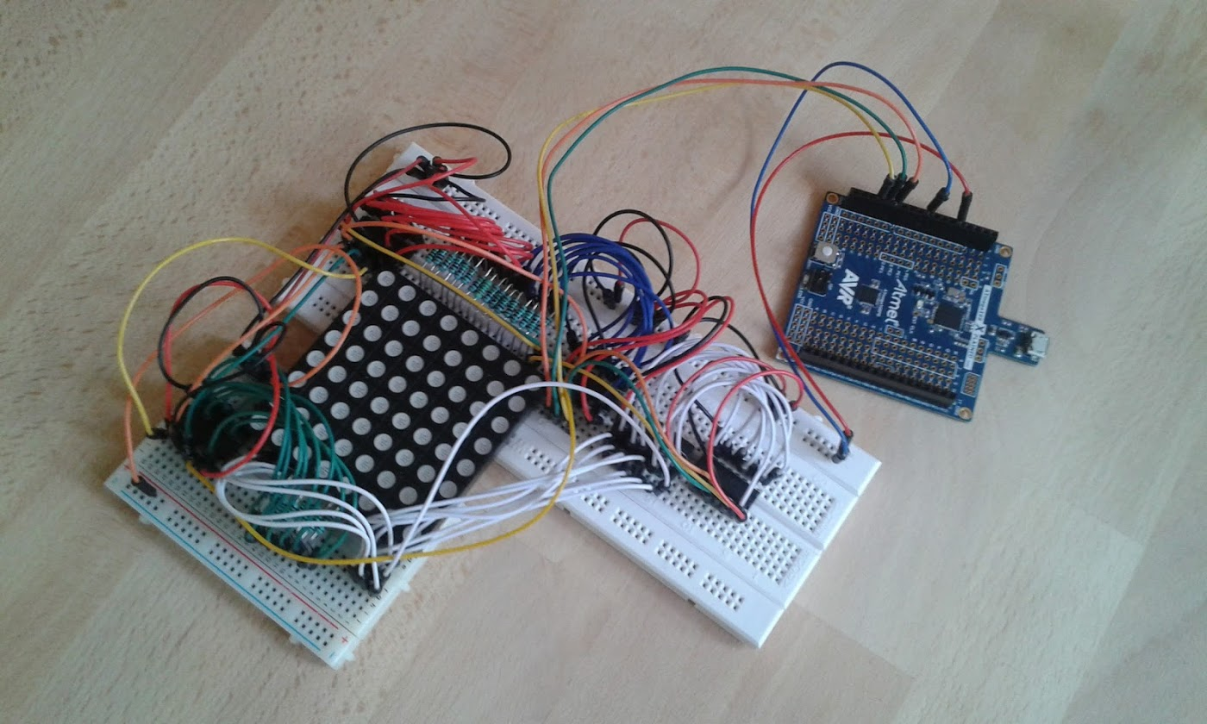
In reality

Slide 26
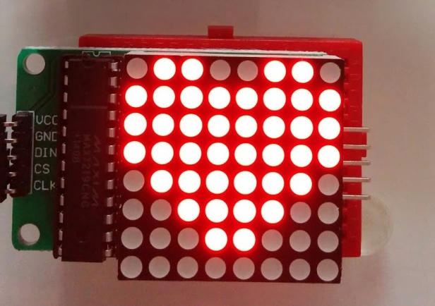
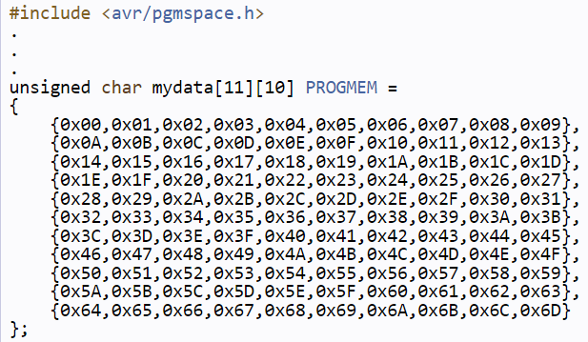
Writing on a LED matrix
For loops
Bitmaps
RGB+Column: 32 bytes
8 x 4 = 32 bytes per bitmap
Memory for variables: 1024 Bytes -> 32 bitmaps
Program memory
16 kBytes
PROGMEM macro
In-between

Slide 27

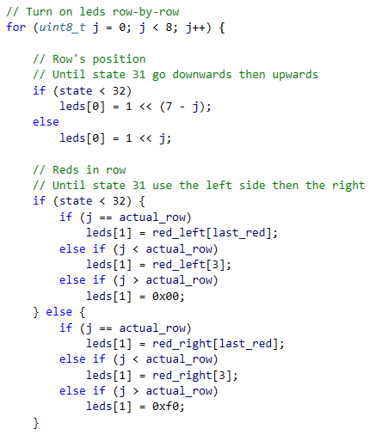
Writing on a LED matrix

Slide 28
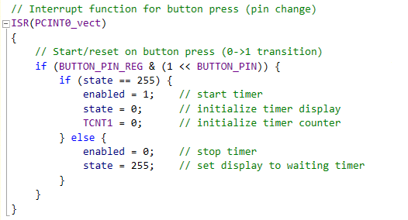
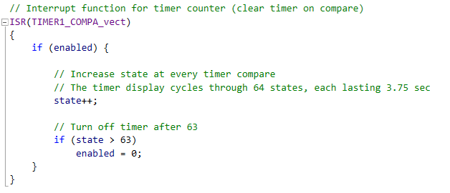
Button and timer

Slide 29
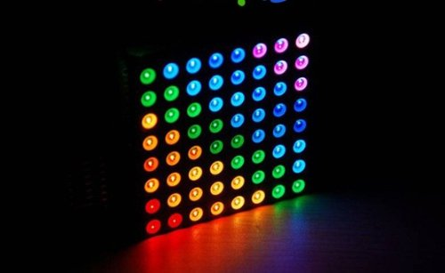
16 777 216 colors?
Using 8 bit timer PWM
RGB: 256 x 256 x 256 colors
In theory only
Human perception:
Non-linear brightness sensing
5% - 1 % > 99% - 95%
Refresh frequency

Slide 30
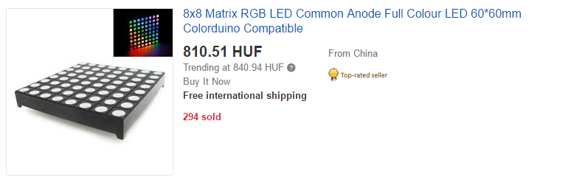
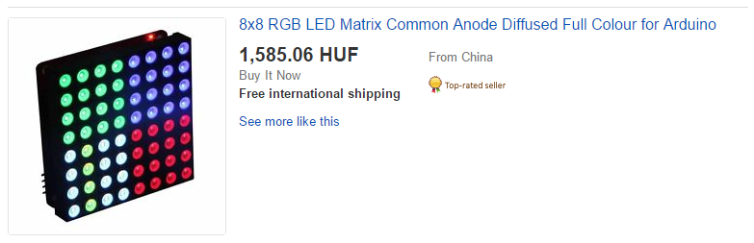
Price range on Ebay

Slide 31
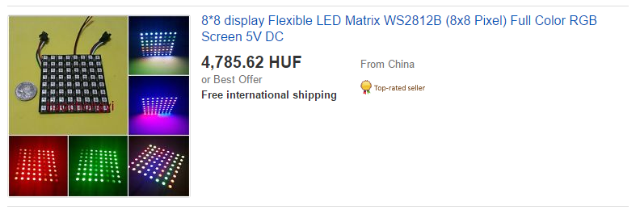
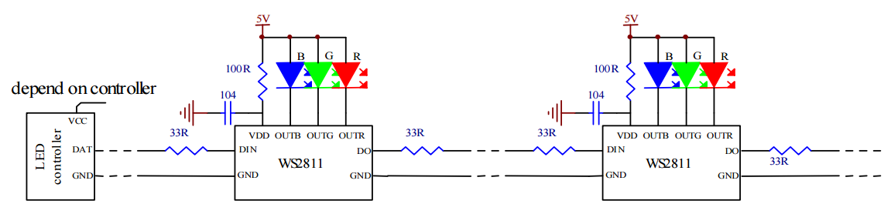
Flexible, addressable LED matrix

Slide 32
Full code available:
https://github.com/skrisztian/led-matrix-timer

